Slide 1
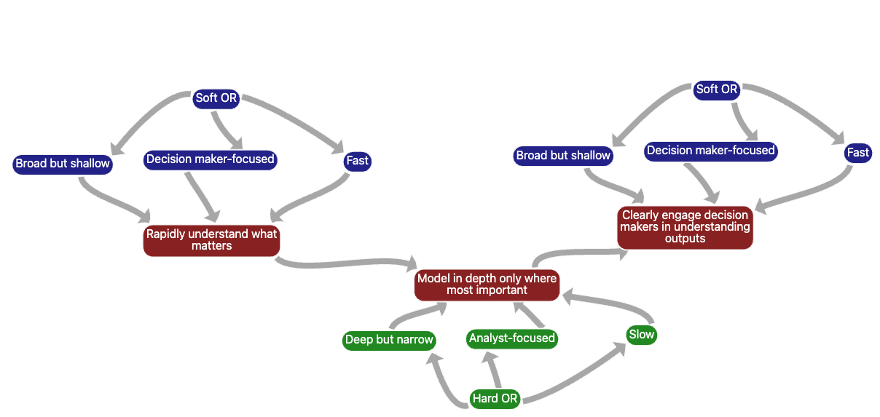
Bridging the gap between soft and hard OR for rapid military applications
ISMOR, 18th July 2024
Rob Solly FORS
Cosimmetry

Slide 2
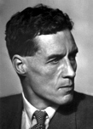
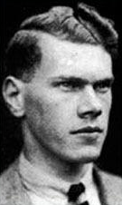
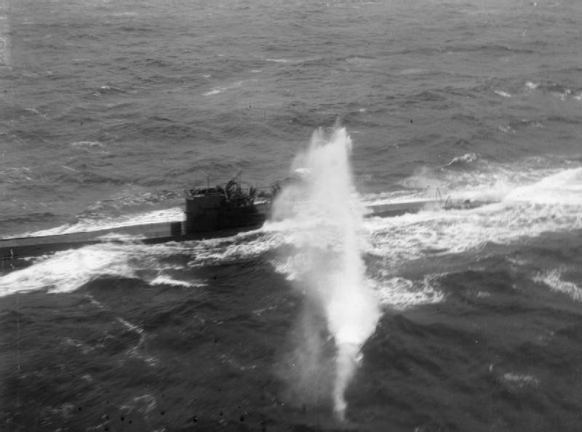
OR’s birth in WW2 involved many rapid applications
Chaotic
Complex
Complicated
Clear
 | Decades | Years | Months | Weeks | Days | Hours | Minutes | Seconds | mSecs
Patrick Blackett
RV Jones
Complexity
Tactics
Urgency
Notes:
In WW2, OR techniques and practitioners by necessity had to conduct rapid analysis of high consequence problems
- e.g. developing tactics for existing systems, often in only days, weeks or months
Introduce Patrick Blackett (or Goodeve?), work on U-Boats, convoys, Air Defence
Introduce RV Jones’ work on intelligence, countering the beams used to guide German aircraft to their targets
Explain his argument that systems were reverse engineered and countered by the Germans in about 3 months - driving real pace into the development of new systems and tactics
- we were at war. It worked fast and it went well
- It was very tactical
Explain the scales on the diagram
The x axis shows the main issue I am trying to highlight, the Urgency with which analysis needs to be completed, and its results put into action. This is something that we are going to need to reinvigorate.
The y axis uses Dave Snowden’s Cynefin scale for Complexity as a proxy for a number of things:
Firstly, some systems are inherently hard to understand and control, due to their complexity:
Multiple interacting parts (complexity)
Humans as part of the system
Adversarial behaviour
Secondly, some systems have only been partially observed and/or are very new, creating uncertainty:
Known unknowns
Unknown unknowns
Unknown knowns

Slide 3
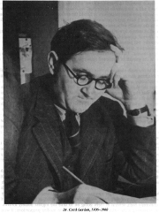
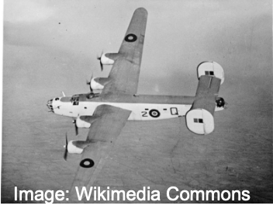
OR’s birth in WW2 involved many rapid applications
Chaotic
Complex
Complicated
Clear
 | Decades | Years | Months | Weeks | Days | Hours | Minutes | Seconds | mSecs
Cecil Gordon
Complexity
Operational use
Urgency
Notes:
Some work was a little slower to complete, for example work on the operational use of fleets of aircraft conducted by Cecil Gordon
Weeks, months and sometimes even years, but still analysis of Clear or Complicated problems

Slide 4
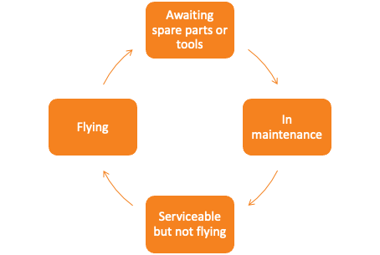
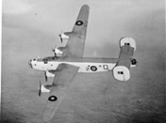
Cecil Gordon: doubling RAF flying hours with simple algebra
Coastal Command’s target: 70-75% serviceability
Notes:
Cecil Gordon was an operational researcher working for Coastal Command
Not enough aircraft, reserved for bomber Command
Found a way to double the number of flying hours using simple algebra
Diagram shows cycle an aircraft goes through
Coastal Command had a target that 70-75% of their aircraft should be serviceable at any one time

Slide 5
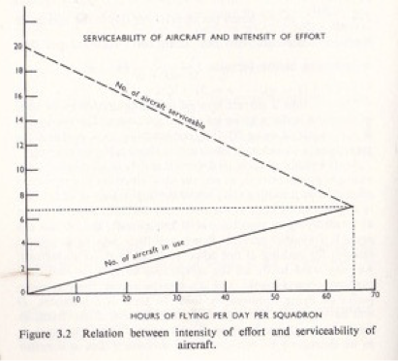
Cecil Gordon: doubling RAF flying hours with simple algebra
Recommendation from theory:
Stop aiming for 70-75% serviceability
Fly when ready
Figure from Waddington, CH, OR in World War 2 Operational Research against the U boat, Elek Scientific Books (1973).
Notes:
Gordon realised that maximising servicability required minimising hours flown
The chart on the right shows this
He recommended a Fly when ready approach instead

Slide 6
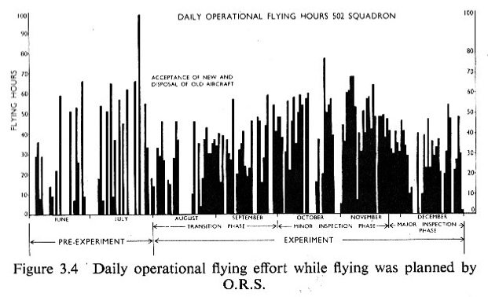
Cecil Gordon: doubling RAF flying hours with simple algebra
3.3% of hours flying
6% of hours flying
29% of hours serviceable
Notes:
The effects of Gordon’s approach are shown in this graph
He doubled the % of time aircraft were flying
Looking back at Gordon’s work, he looked at the system, narrowed down the part of it that needed analytical attention, built a very simple theoretical model, clearly communicated it to decision makers and then tested it in an experiment using real aircraft

Slide 7
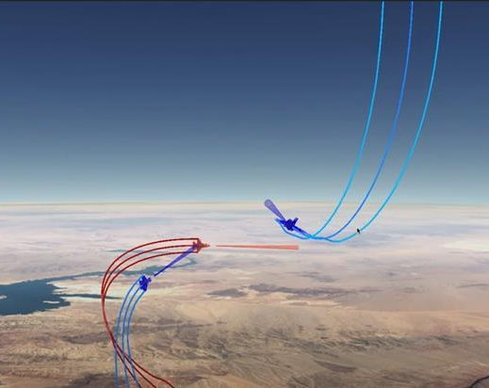
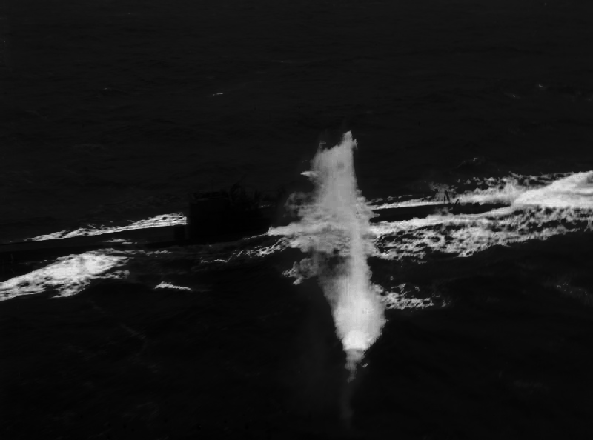
Since WW2, slower analysis of more complicated problems has become the norm
Chaotic
Complex
Complicated
Clear
 | Decades | Years | Months | Weeks | Days | Hours | Minutes | Seconds | mSecs
Complexity
Tactics
Tactics
Urgency
Notes:
Since WW2, OR techniques and practitioners have switched their focus from rapid analysis of simple high consequence problems
to slower analysis of more complicated problems
E.g. for analysis of tactics, greater computing power = ability to study more variables, more complicated analysis

Slide 8
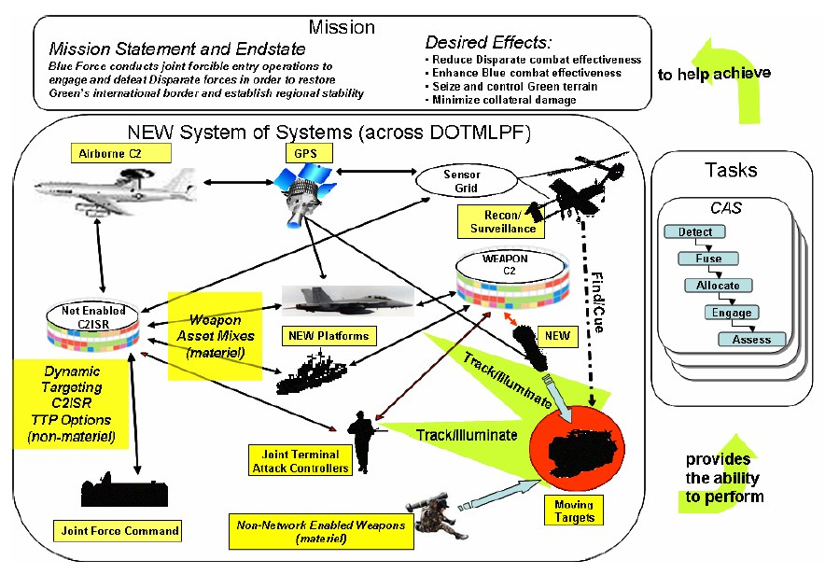
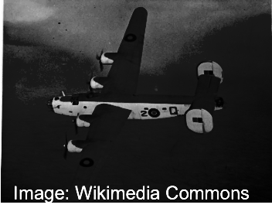
Since WW2, slower analysis of more complicated problems has become the norm
Chaotic
Complex
Complicated
Clear
 | Decades | Years | Months | Weeks | Days | Hours | Minutes | Seconds | mSecs
Complexity
Operational use
Operational use
Urgency
Notes:
And at the same time, analysis of operational use now needs to take into account far greater levels of interaction between systems = more complicated battlespace, complex too
Operational use

Slide 9
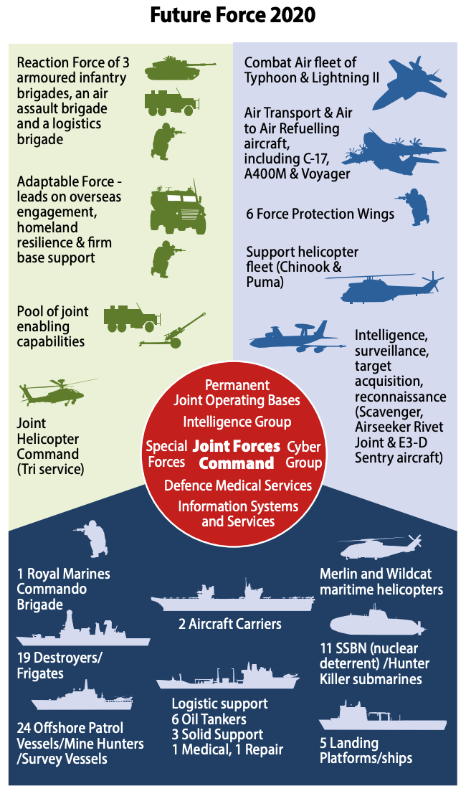
Since WW2, slower analysis of more complicated problems has become the norm
Chaotic
Complex
Complicated
Clear
 | Decades | Years | Months | Weeks | Days | Hours | Minutes | Seconds | mSecs
Strategy
Force/
Campaign/Society
Performance data
Requirements data
Systems of Systems/
Operational/Groups
Complexity
Systems/Tactical/Individuals
Investment strategy
Operational use
Tactics
Physical/Physiological Processes
Urgency
Notes:
And analysis is now routinely used to support decisions on investment strategy across portfolios of numerous interacting systems
- optimising force structure for future operations is hugely complex and requires large amounts of analytical effort
Attempts to integrate analysis across multiple areas, creating interdependencies and time delays
More complicated analysis
Taking months or years to build models and data has become the norm, increasing stakeholders’ confidence, but slowing analysis and reducing OR’s ability to drive innovation into decisions.
When we stopped being at war we had the comfort of time, and we filled that with more detail / rigour so it got slow but still effective
Got more strategic questions which were much larger and much more complicated. Trying to build a complicated model of this got very difficult

Slide 10
Hard OR supports a Reductionist approach to decisions
Chaotic
Complex
Complicated
Clear
 | Decades | Years | Months | Weeks | Days | Hours | Minutes | Seconds | mSecs
Reductionist Analysis - splitting problem into parts, building new models to solve each part and synthesising results
Complexity
Investment strategy
Operational use
Tactics
Urgency
Notes:
All of this supports a decision making process that I call Reductionist Analysis - splitting a problem into parts, building new models to solve each part and synthesizing the results.
Analytical bureaucracy works well for the bottom left of this chart, ie. when a problem is complicated and you have weeks, months, or years to solve it

Slide 11
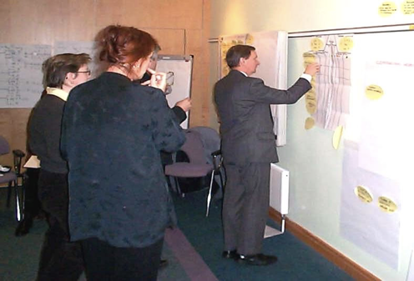
Soft OR supports a Collaborative Strategy approach
Chaotic
Complex
Complicated
Clear
 | Decades | Years | Months | Weeks | Days | Hours | Minutes | Seconds | mSecs
Collaborative Strategy - large teams of people scanning for useful information, loosely collaborating, building new models
Reductionist Analysis - splitting problem into parts, building new models to solve each part and synthesising results
Complexity
Investment strategy
Operational use
Tactics
Urgency
Notes:
But Reductionist Analysis is not suitable for the top left of this chart, for problems that are complex or chaotic. In this space, problems are usually solved through a process of Collaborative strategy, where large teams of people scan for useful information, loosely collaborating, building new models as they go.
This is the preserve of Soft OR
Russ Ackoff showed that people had optimised a subset of the problem, and they really believed their models
Soft methods came in to work out what the question was and how best to solve the problem
Using forms of opinions rather than quantitative measures and opinions change
Can have rigour within soft methods (PSMs) - helped think what was going on in order to move to a problem solving strategy

Slide 12
But now we need to get back to Rapid Analysis & Planning
Chaotic
Complex
Complicated
Clear
 | Decades | Years | Months | Weeks | Days | Hours | Minutes | Seconds | mSecs
Rapid OR is still undertaken, but either in predictable situations where old models and data can be re-used, or using soft OR methods based on subjective judgements and limited robustness.
Collaborative Strategy - large teams of people scanning for useful information, loosely collaborating, building new models
Rapid Analysis & Planning - a team of trained people collaborating and rapidly developing models
Reductionist Analysis - splitting problem into parts, building new models to solve each part and synthesising results
Complexity
Investment strategy
Operational use
Tactics
Urgency
Notes:
But neither of these approaches are suitable for decision making in warfare
We need to get back to a deicsion making process I call Rapid Analysis and Planning
Cynefin, sometimes have to act.
Diagram, lit review
We are now at war again (some of us are already, others might well be soon) so we cannot be slow any more
We’ve got to get back to that place in WW2 where we are both fast and good

Slide 13
Sketch is designed for Rapid Analysis & Planning
Notes:
We have developed Sketch to fill this gap
Replicating the process that Cecil Gordon and his team went through
Making soft work rigorous
Building models collaboratively, people’s views on what might cause something else to happen
Israel / Hamas, zoom in on a bit of it
Simplifying
C490 surrogate, visual analytics to show which things matter most
Post it notes, flipchart retained digitally
Translating conceptual models into calculable models
Star Wars - graphs to show numerical model
Heat flow?
Show layered model - same model, different lens to view it a different way
How long would it take you to do that? Translating from one language to another, it would be horrible. Excel to Python / C
This is unique - multi methodology approach
We’re used to having models that do one thing

Slide 14
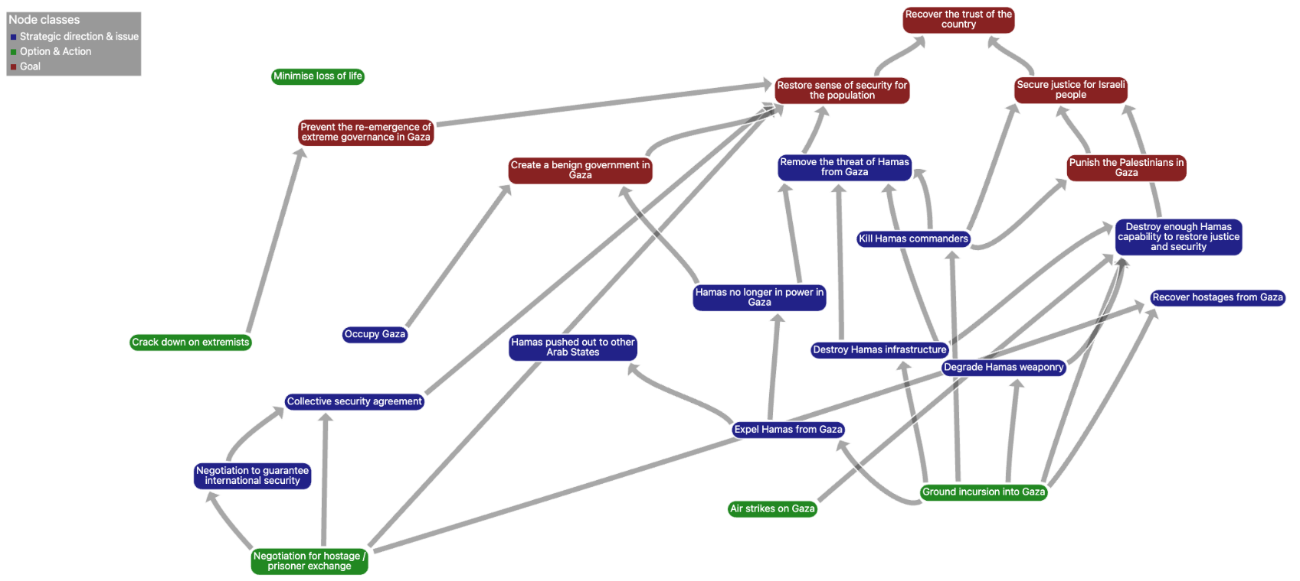
Conceptual models: rapidly eliciting expert wisdom
Notes:
Building models collaboratively, people’s views on what might cause something else to happen
Explain the background to this model and what it represents
Israel / Hamas, zoom in on a bit of it
Only took 20-30 minutes to build each model like this
Mention AI functions: OpenAI interface, Facilitate mode

Slide 15
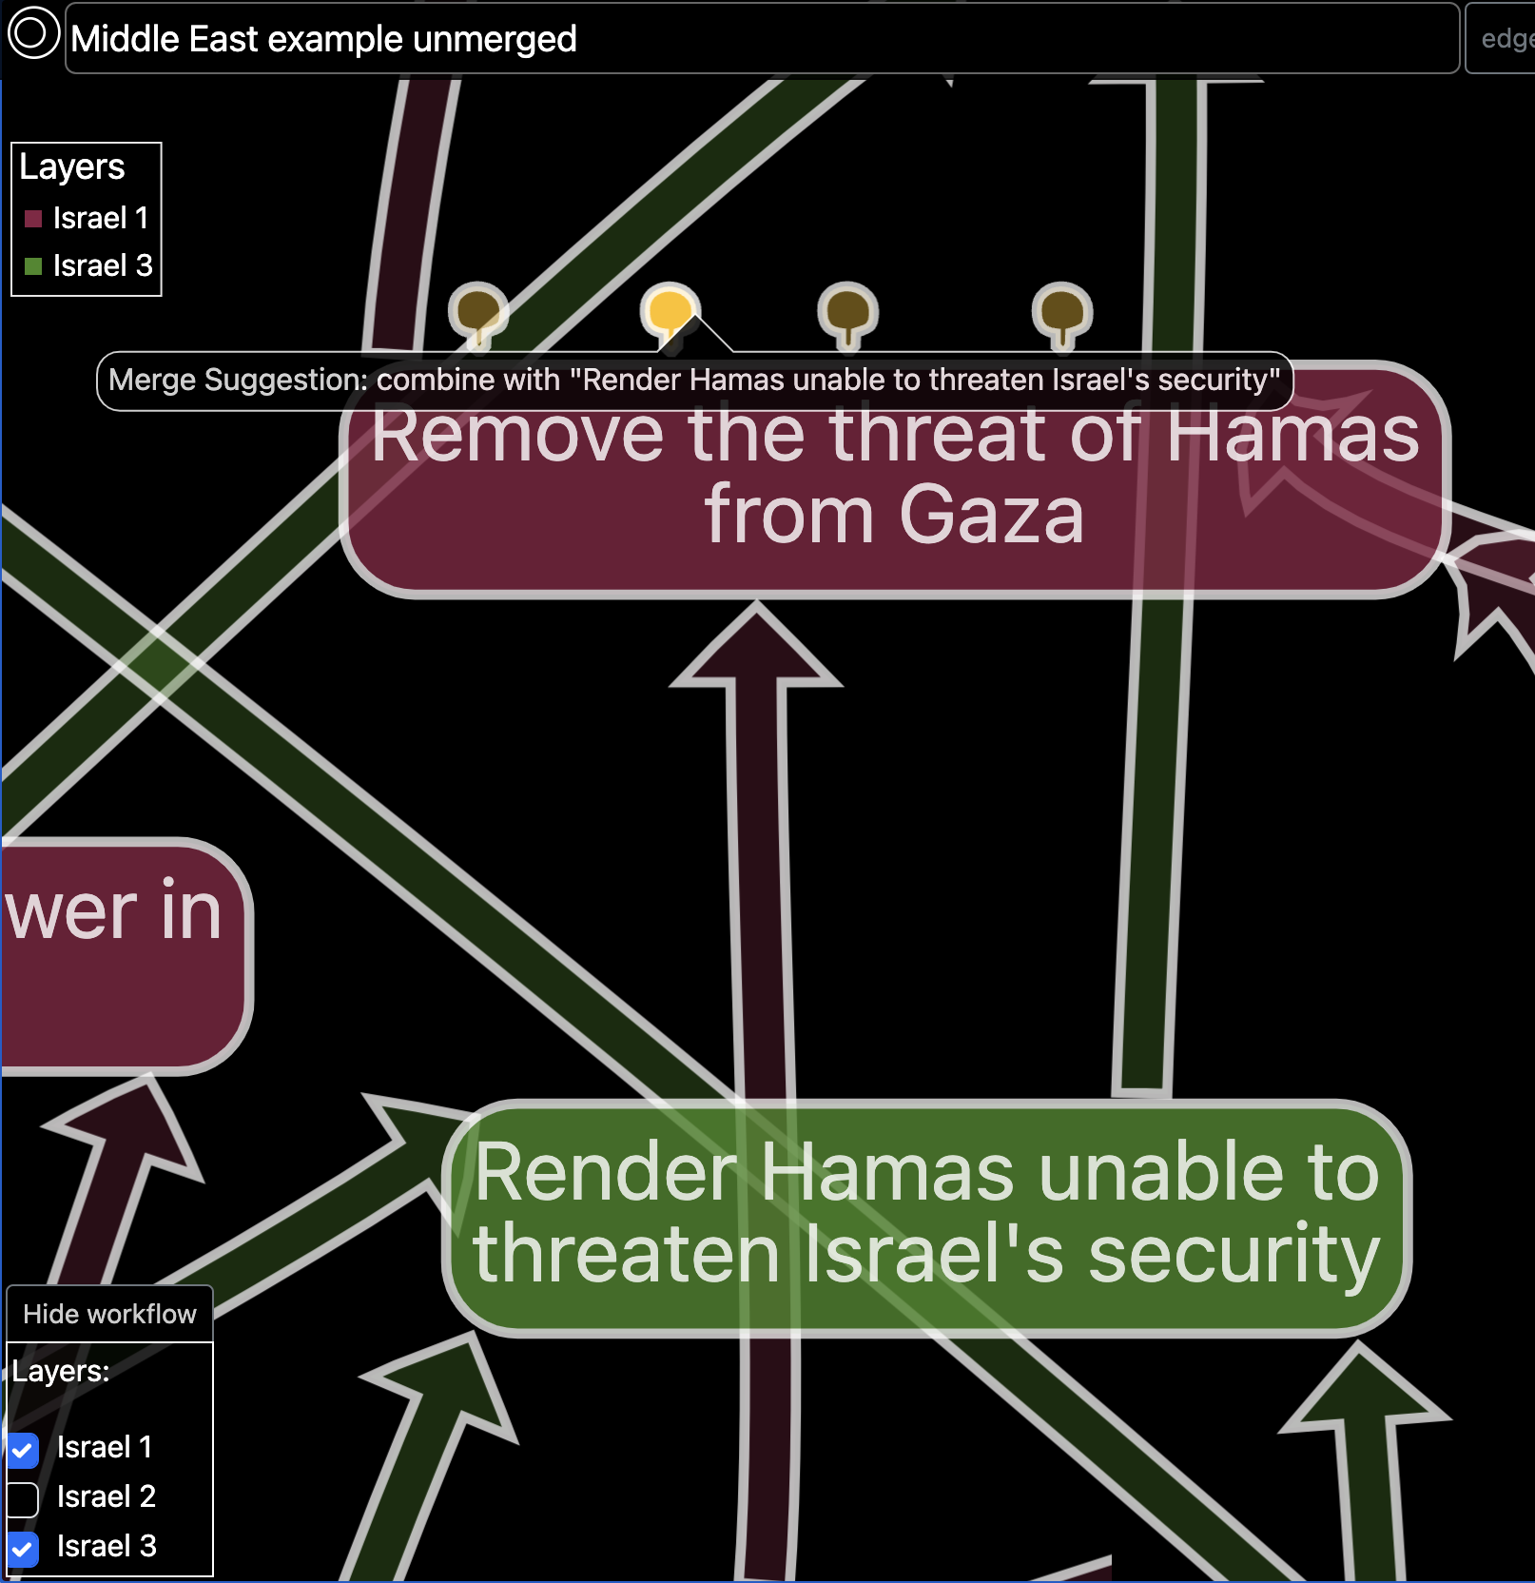
Converging conceptual models from multiple stakeholders
Visually overlay models in layers made by different people or from different perspectives
Drag and drop to combine nodes, stitching together models in different layers
In-built AI searches for nodes with similar names and positions in the model
Merging nodes with free-form ontology is still mentally taxing!
User-defined ontology can make merging far simpler, but at the expense of freedom of model building
Notes:
Building models collaboratively can be done with multiple people collaborating on building one model,
Or multiple layers in a model, each representing one person’s view, or one perspective - which then need to be merged afterwards
Sketch offers advanced functionality to view and converge multiple models
This example shows an overlay of two experts’ models of what Israel might

Slide 16
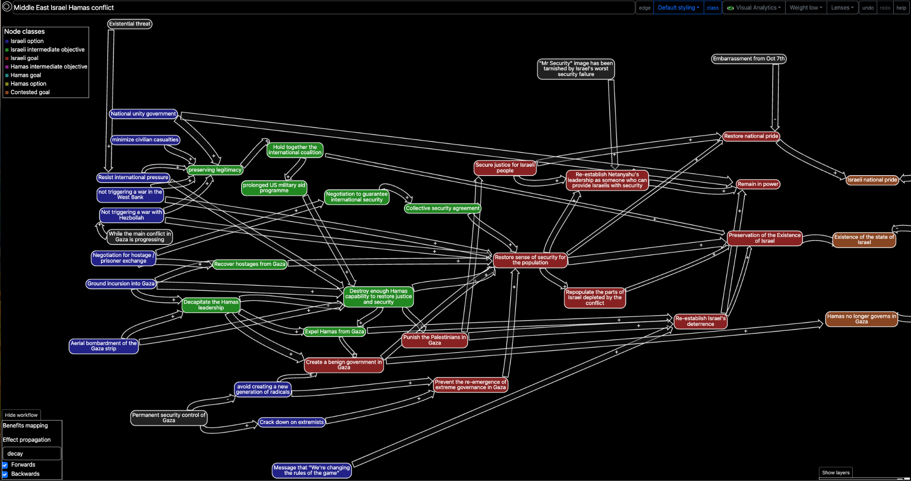
Converged models of one perspective from multiple experts

Slide 17
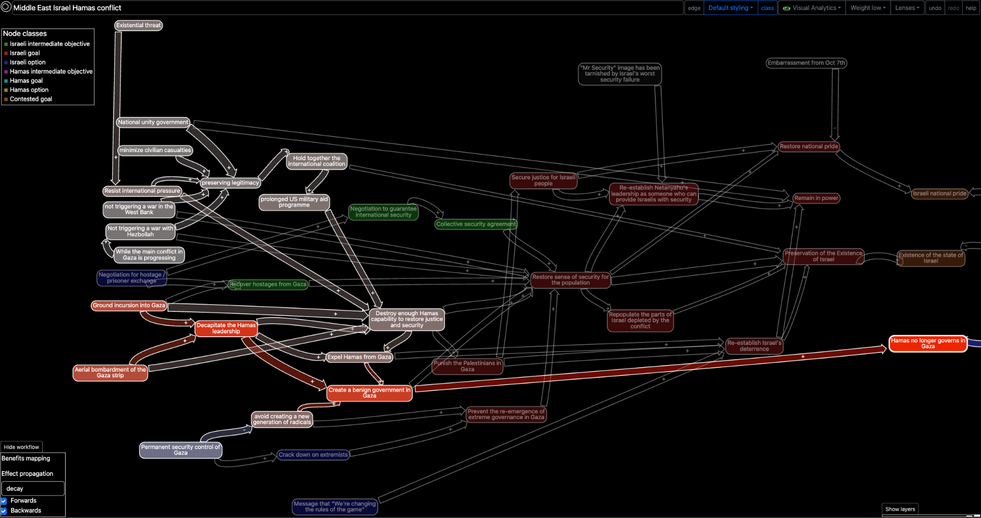
Visual analytics to explore choices with conceptual models

Slide 18
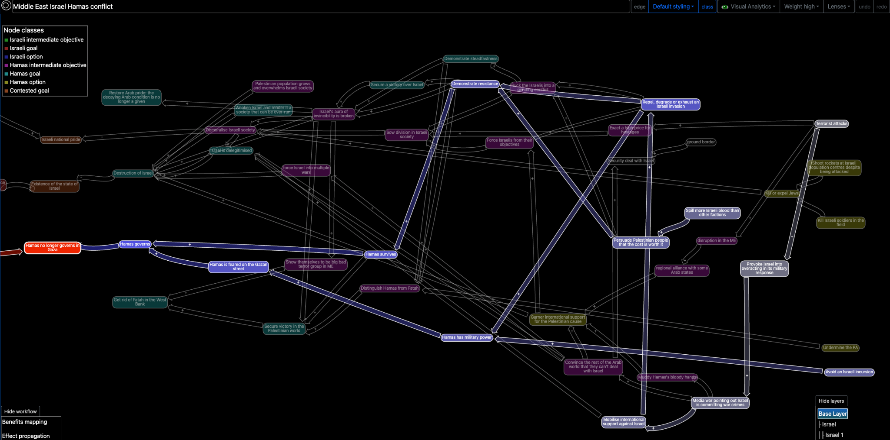
Exploring choices with competing perspectives

Slide 19
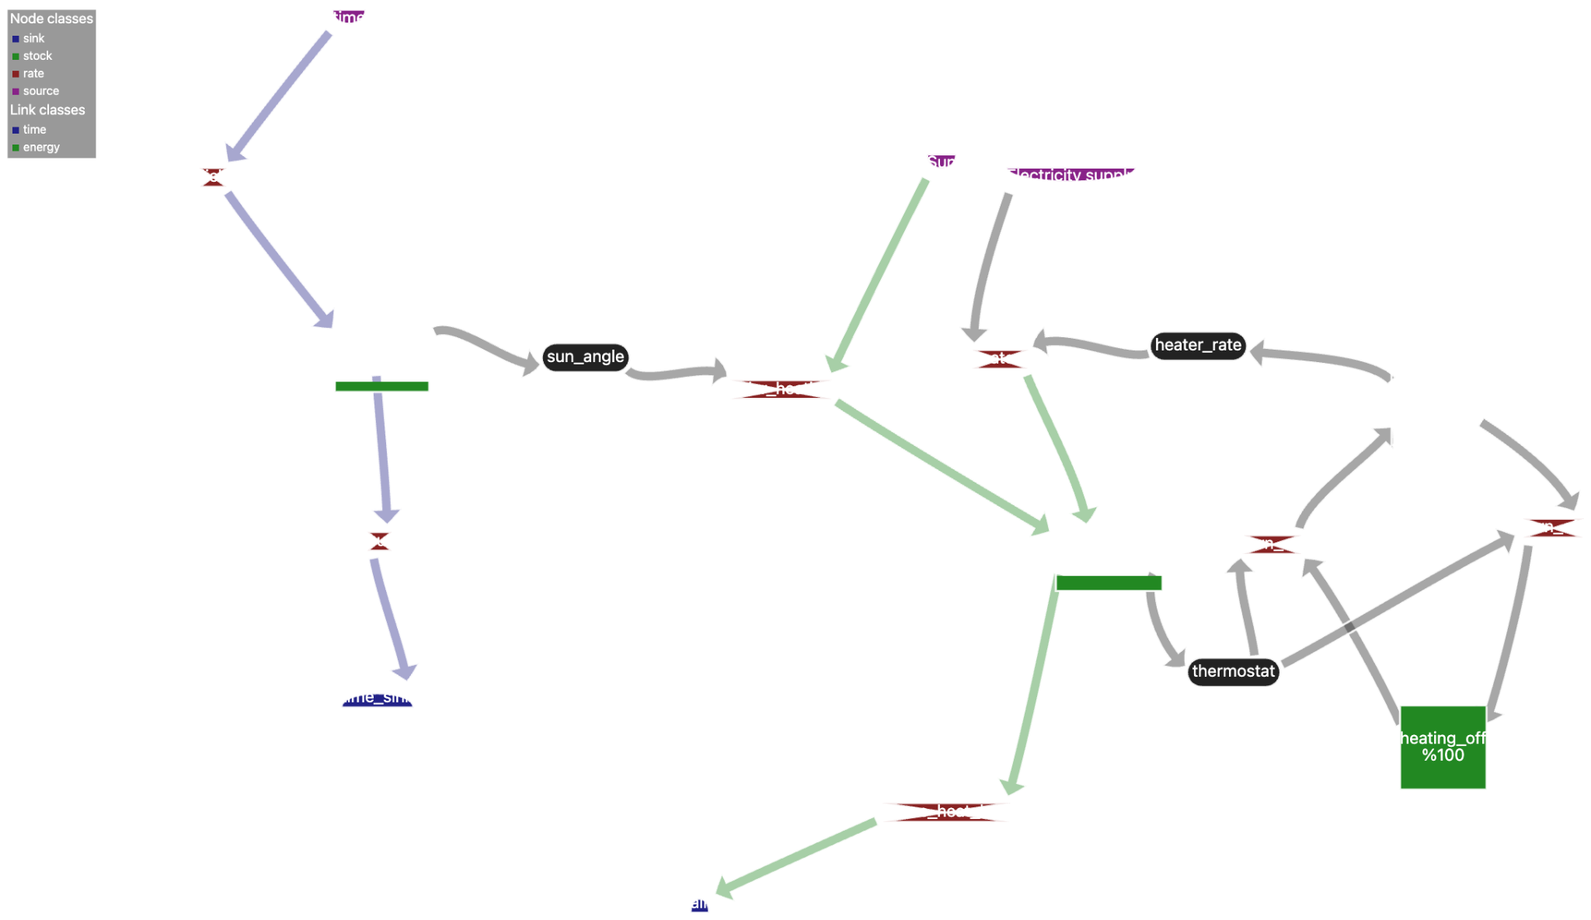
Translating conceptual models into calculable models
Notes:
Translating conceptual models into calculable models
Star Wars - graphs to show numerical model
Heat flow?

Slide 20
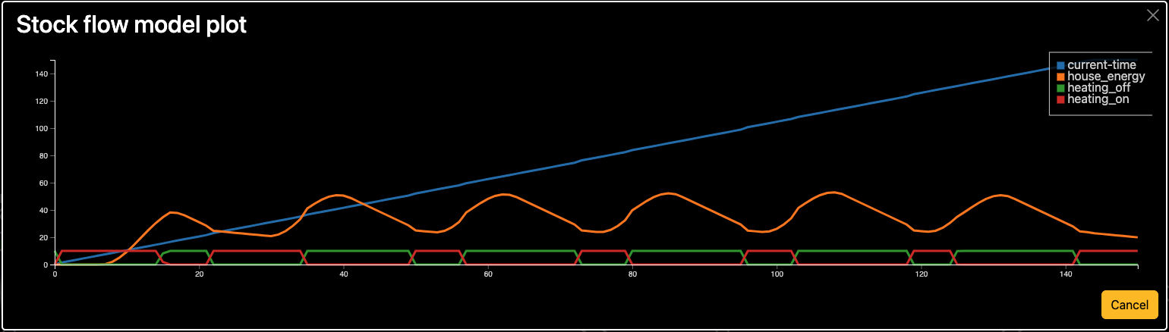
Translating conceptual models into calculable models
Notes:
Translating conceptual models into calculable models
Star Wars - graphs to show numerical model
Heat flow?

Slide 21
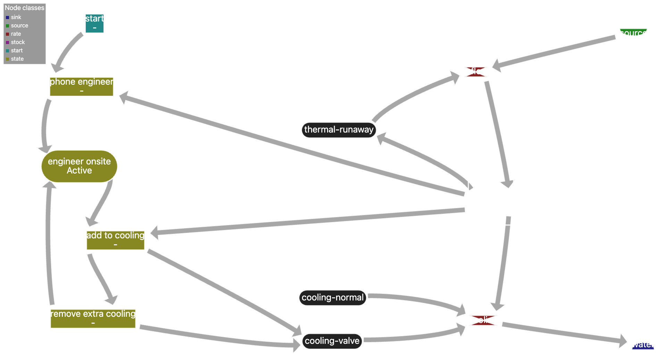
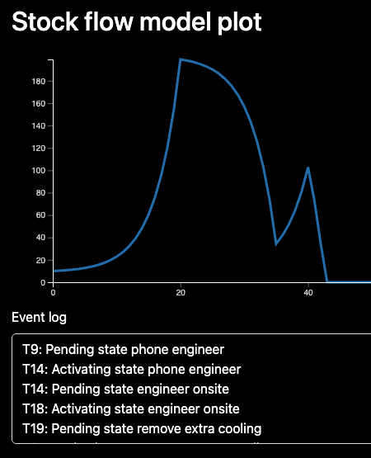
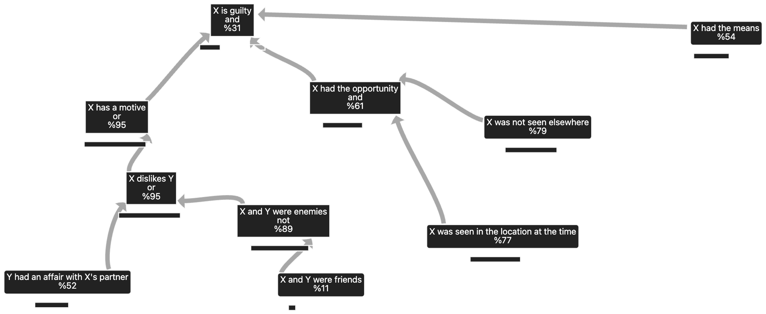
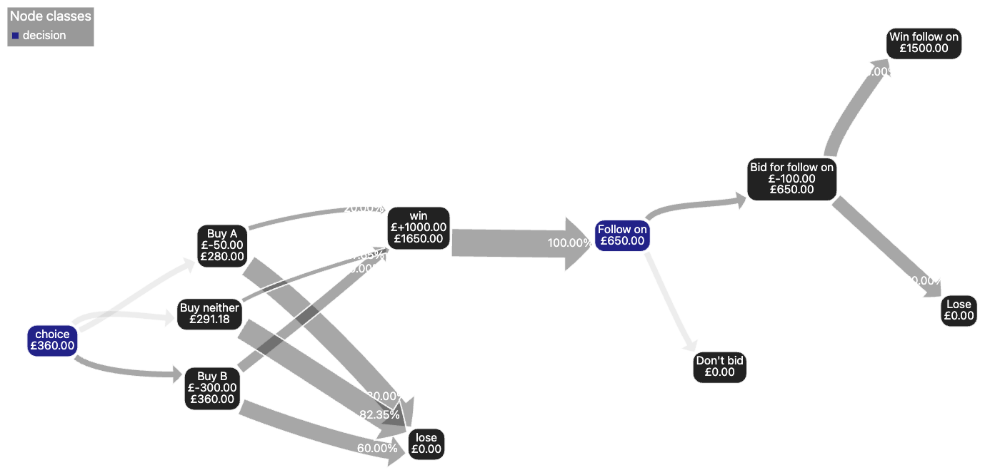
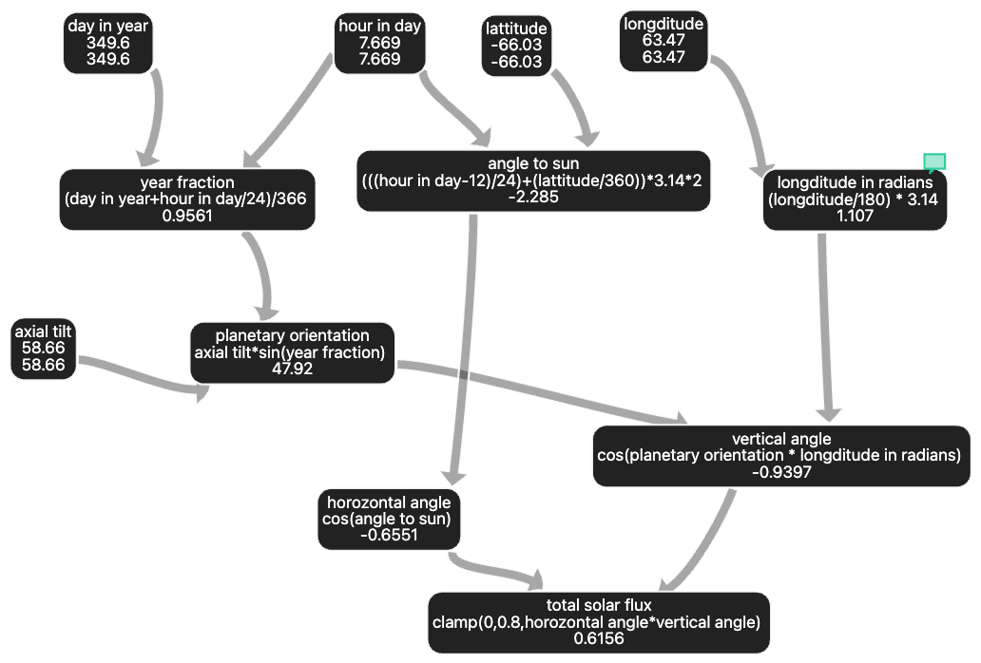
Other calculable modelling workflows
Probability aggregation
Time stepping simulation
Decision tree
Calculation

Slide 22
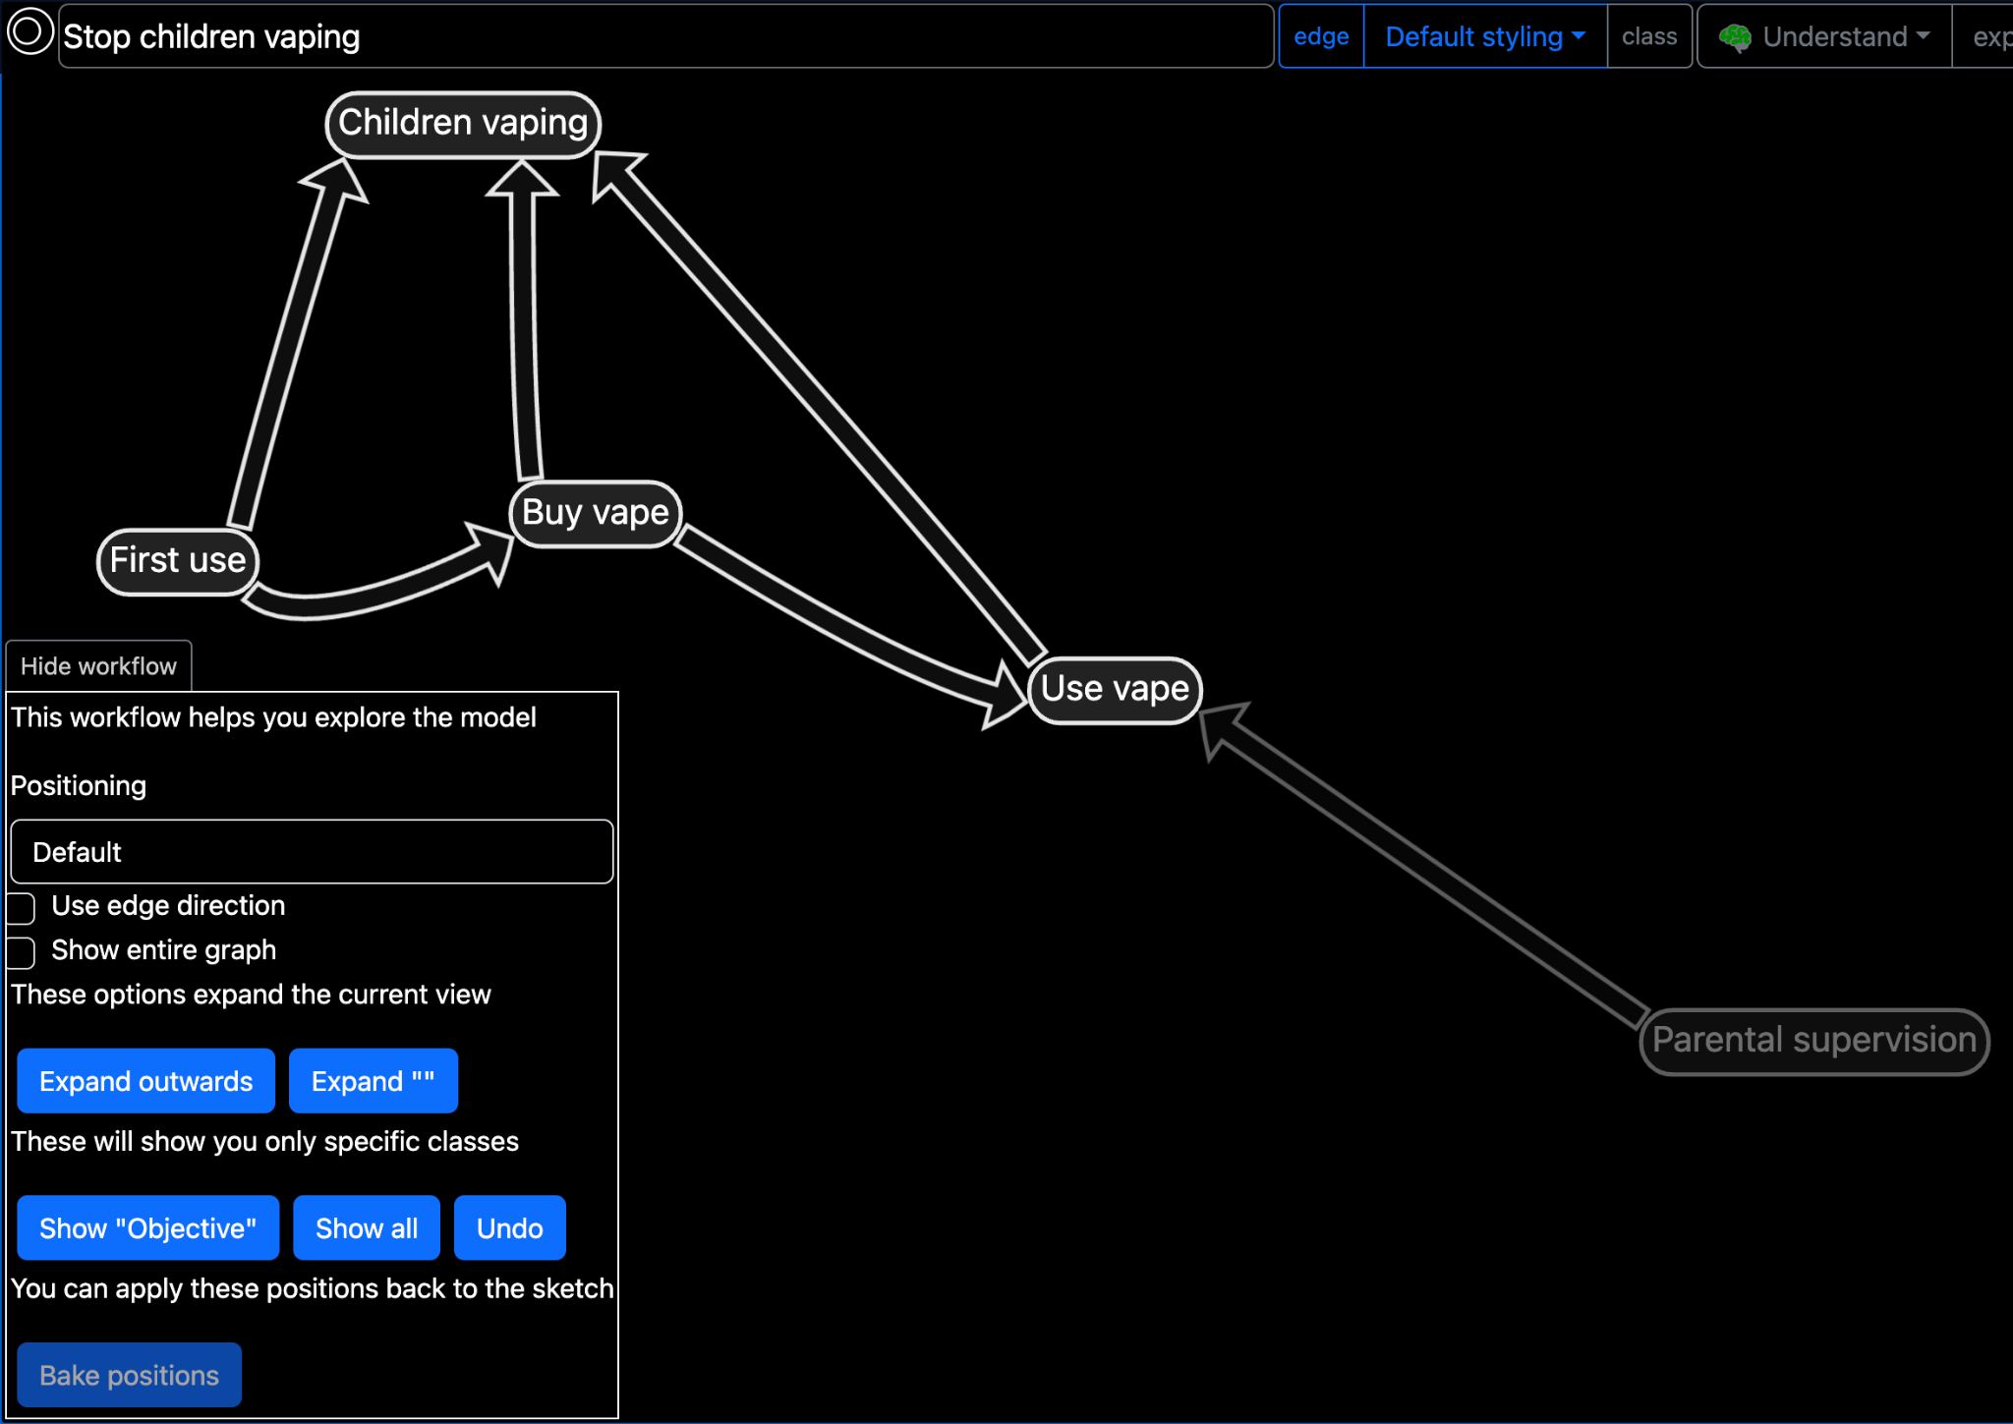
Explaining the theory of change of proposed options
Storytelling functions to explore and explain complex models and the findings of your analysis
AI positioning to understand relationships between similar concepts
Notes:
Something about Understand and Present modes

Slide 23
Enabling Rapid Analysis
Single conceptual model
0.5 hours
Converging multiple conceptual models
4 hours
Focus on key objectives and review option effectiveness
2 hours
Translate to simple calculable model
10 hours
Explain theory of change
1 hour
Rigorous Soft OR
Rapid Hard OR

Slide 24
How Sketch can help across the spectrum of analysis
Chaotic
Complex
Complicated
Clear
 | Decades | Years | Months | Weeks | Days | Hours | Minutes | Seconds | mSecs
Collaborative Strategy - collective intelligence and building shared objectives through collaborative conceptual modelling
Rapid Analysis & Planning - rapid understanding, development and assessment of plans by planners and analysts
Reductionist Analysis - rapid exploratory analysis to focus more detailed studies
Complexity
Operational use
Tactics
Urgency
Notes:
But neither of these approaches are suitable for decision making in warfare
We need to get back to a deicsion making process I call Rapid Analysis and Planning
Cynefin, sometimes have to act.
Diagram, lit review
We are now at war again (some of us are already, others might well be soon) so we cannot be slow any more
We’ve got to get back to that place in WW2 where we are both fast and good

Slide 25
Q&A

Slide 26
Abstract
Since WW2, OR techniques and practitioners have switched their focus from rapid analysis of simple high consequence problems - e.g. developing tactics for existing systems - to slower analysis of more complicated problems - e.g. optimising force structure for future operations. Taking months or years to build models and data has become the norm, increasing stakeholders’ confidence, but slowing analysis and reducing OR’s ability to drive innovation into decisions. Rapid OR is still undertaken, but either in predictable situations where old models and data can be re-used, or using soft OR methods based on subjective judgements and limited robustness.
This presentation shows through examples from recent studies how Cosimmetry’s Sketch tool uniquely fills this gap using soft OR to rapidly capture expert knowledge into conceptual models, and AI-assistance helping users to translate these into calculable hard OR models for rapid, but broad and shallow analysis suitable for urgent, high consequence problems.

Slide 27
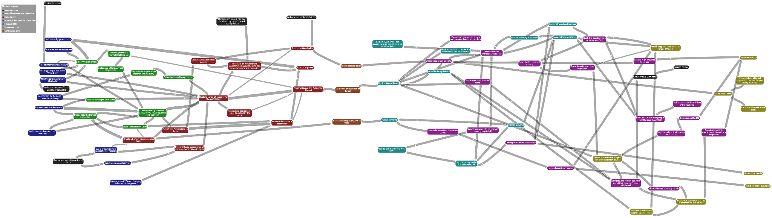
Converged models of competing perspectives

Slide 28
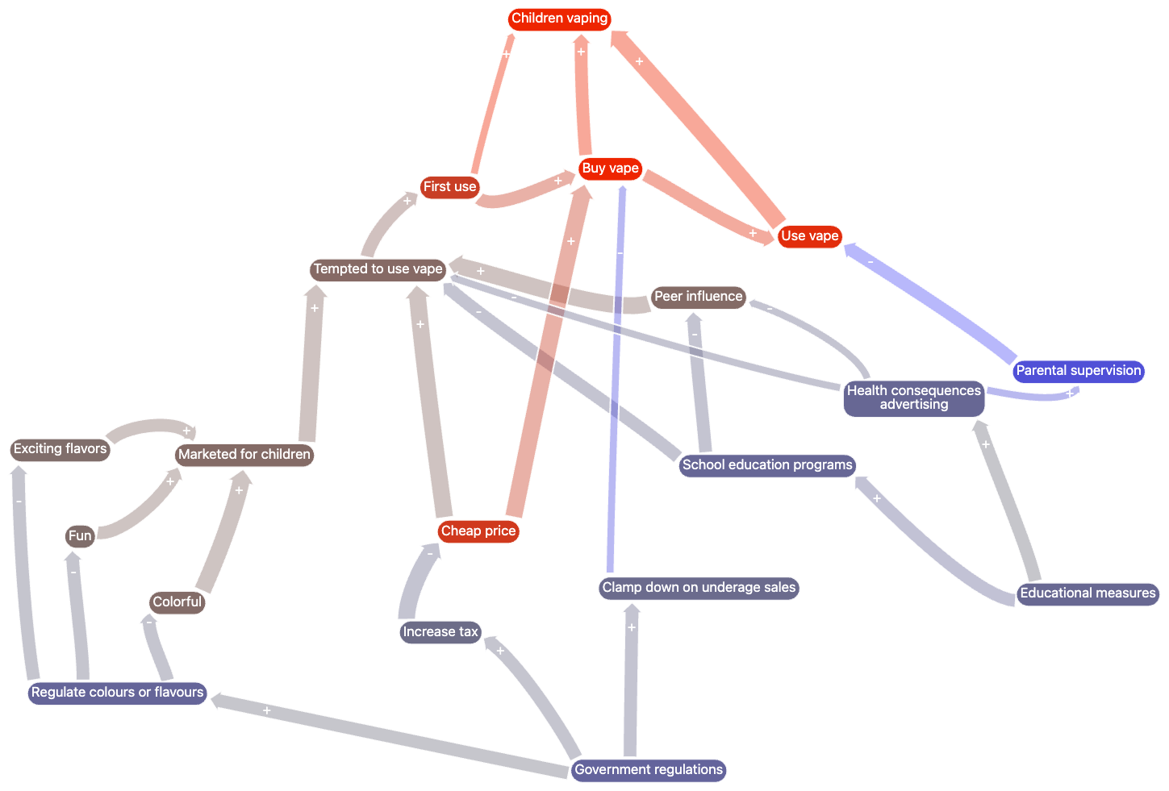
Visual analytics to explore choices with conceptual models

Slide 29
Uncertainty
Model fidelity / detail
Figure modified from Leinweber, D. (1979).

